Slide 1
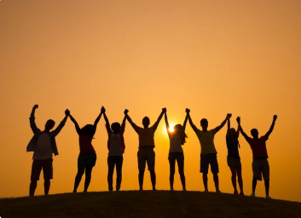

Slide 2
Judges 6:12
¹² When the angel of the Lord appeared to Gideon, he said, “The Lord is with you, mighty warrior.”

Slide 3
Called to be
Victorious
Judges 6:12
Sis. Liezel

Slide 4
I. CHOSEN AMONG THE LEAST
Judges 6:15
¹⁵ “Pardon me, my lord,” Gideon replied, “but how can I save Israel? My clan is the weakest in Manasseh, and I am the least in my family.”

Slide 5
II. MIRACLE IN THE FLEECE
Judges 6:36-40
³⁶ Gideon said to God, “If you will save Israel by my hand as you have promised— ³⁷ look, I will place a wool fleece on the threshing floor. If there is dew only on the fleece and all the ground is dry, then I will know that you will save Israel by my hand, as you said.” ³⁸ And that is what happened. Gideon rose early the next day; he squeezed the fleece and wrung out the dew—a bowlful of water.

Slide 6
II. MIRACLE IN THE FLEECE
Judges 6:36-40
³⁹ Then Gideon said to God, “Do not be angry with me. Let me make just one more request. Allow me one more test with the fleece, but this time make the fleece dry and let the ground be covered with dew.” ⁴⁰ That night God did so. Only the fleece was dry; all the ground was covered with dew.

Slide 7
III. VICTORY FROM THE DECREASE
Judges 7:2-4
² The Lord said to Gideon, “You have too many men. I cannot deliver Midian into their hands, or Israel would boast against me, ‘My own strength has saved me.’ ³ Now announce to the army, ‘Anyone who trembles with fear may turn back and leave Mount Gilead.’” So twenty-two thousand men left, while ten thousand remained.

Slide 8
III. VICTORY FROM THE DECREASE
Judges 7:2-4
⁴ But the Lord said to Gideon, “There are still too many men. Take them down to the water, and I will thin them out for you there. If I say, ‘This one shall go with you,’ he shall go; but if I say, ‘This one shall not go with you,’ he shall not go.”

Slide 9
CONCLUSION
With whatever little we have, surrender it in the hands of God, it will surely be a miracle.
2. God can work through what ever little you have.
3. Our limitations are God’s entry point workin his limitless power in us.

